Slide 1

Buy or Sell your products with us

Slide 2
Summary
Consumer-to-consumer and business-to-consumer sales services via the Internet.
The purpose of this project is to develop an online e-store which allows customers to do online shopping. Our website junkReSell is an E-commerce web application which allows customers to buy or re-sell new or used items. We used a three-tier approach to develop the application. The front-end user interface incorporates HTML, Javascript, CSS, and Bootstrap. For the middle tier, the website uses PHP. The back-end data processes are handled by MySQL database as the server. Apache was used as the web server. The website can be deployed to XAMPP 1.8.3.

Slide 3
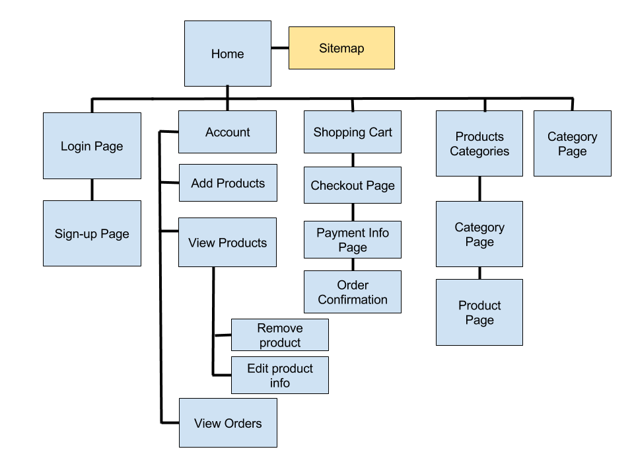
Architecture

Slide 4
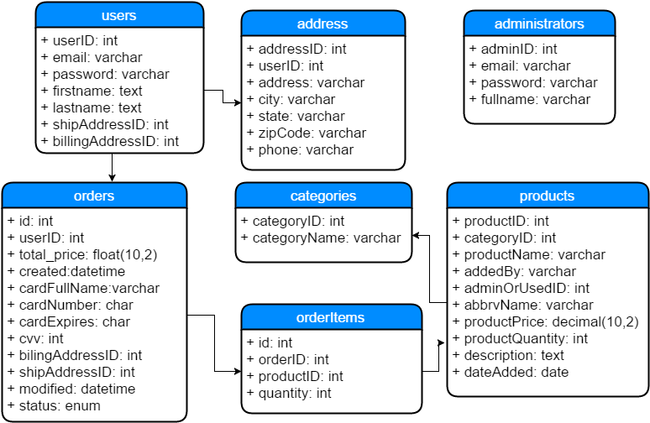

Slide 5
Features
Navigation
Homepage product layout
Account
Category
Cart
checkout
Admin

